Slide 1

DATA SCIENCE
FINAL PROJECT
CAN WE PREDICT THE LEAGUE RANKINGS IN THE SPANISH LEAGUE?
1

Slide 2
STUDENTS
Yarin Ifargan
Dudi Kreis
2

Slide 3
PROJECT BREAKDOWN
Step 1 – Crawling + Cleaning
crawling from ‘bdfutbol’ Spanish League from 1929 to 2022. Total of 93 Seasons. Examination of the data. After first examination – renamed the Spanish club names into English terms using dictionary. Removing unnecessary columns – P,YC,RD. Saving the data as csv ‘data’ to avoid repeat crawling process.
Step 2 – EDA
Examination of the full data as csv. Examining the stats of the Top 10 teams from all seasons. Visualize the connection between the variables Rank Team Year Detecting Outliers using normalized columns. Calculate correlation between numeric values.
Step 3 – ML Models
Examining the data by 3 different models Linear Regression Decision Tree K-means Linear and Decision Tree Predict the Points of ‘x’ amount of season for specific team Predict all teams Ranks in the table league from all the seasons K-means Classification into 3 clusters by using an unsupervised model
Step 4 – Conclusion
Examining the result of each model. Comparing the results we got in each model, and accordingly decide which model was better.
3

Slide 4

FIRST STEP - CRAWLING
4

Slide 5
HOW DID WE CREATE THE DATA BASE
Used crawling process to get Spanish League data
From season 29/30 to season 21/22
Total of 93 years
5

Slide 6
CRAWLING LA LIGA DATA FROM BDFUTBOL
Crawling using BeatifulSoup
Creating Data Frame which contains the whole data from all seasons
Translating Spanish club names into English ones
Dropping unnecessary columns – P,YC,RD
6

Slide 7
OUR DATABASE
Data | Number of teams | Number of Goals | Number of Points | Seasons
La Liga seasons table | 64 | 74408 | 60135 | 93 (21/22 included)
7

Slide 8

VISUALIZE THE DATA
8

Slide 9
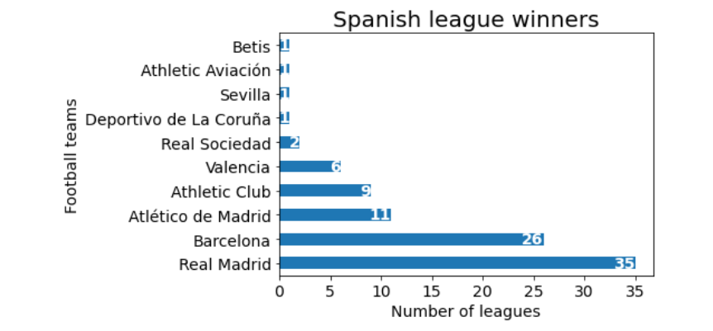
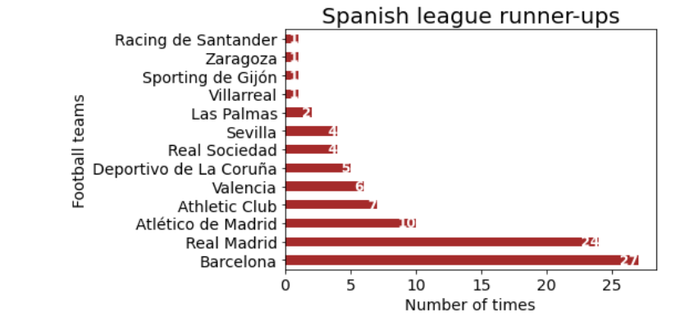
SPANISH LEAUGE WINNERS
9

Slide 10
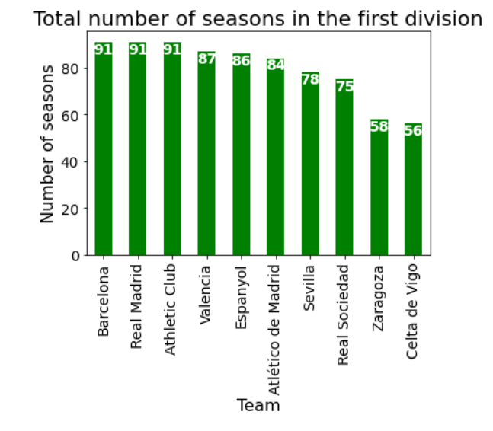
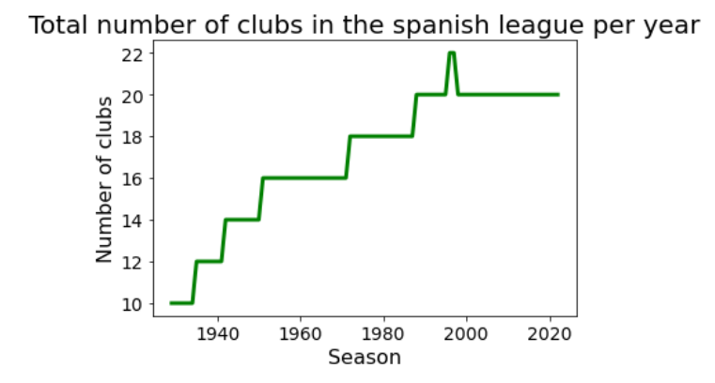
MORE VISUALIZATIONS EXAMPLES
10

Slide 11
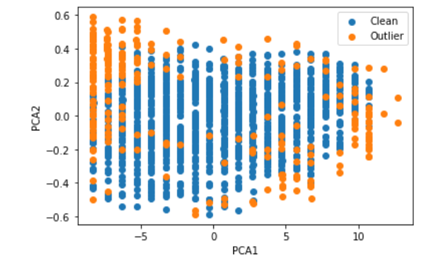
DETECTING OUTLIERS
11

Slide 12

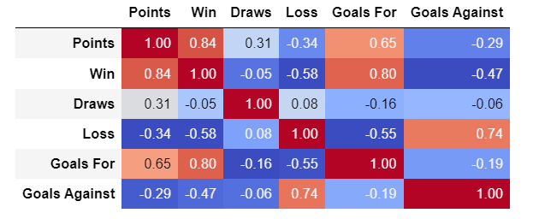
CORRELATION BETWEEN THE NUMERIC FEATURES
12

Slide 13
ANSWERING A FEW QUESTIONS
After crawling the data and getting the information that we need, lets check few questions:
What are the ‘x’ amount of ‘Goals for’ ,’Goal against’ ,’Points’ required Inorder to be Top 10 at the end of the season?
Can we predict the team ‘Points’ of ‘x’ season?
Can we predict the team ‘Rank’ at the end of each season?
13

Slide 14
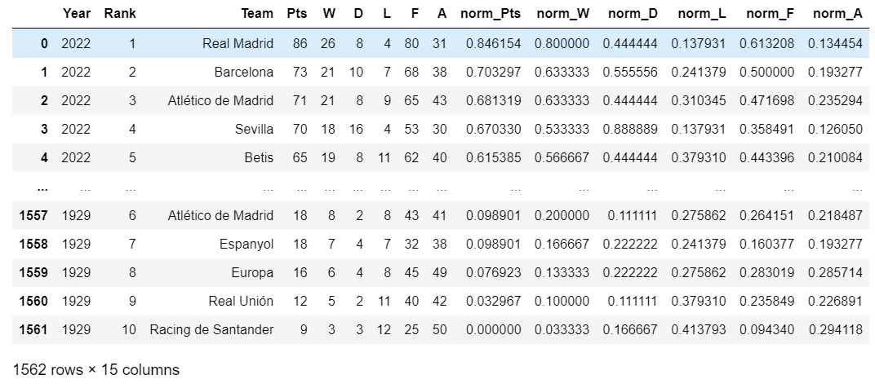
ADDITIONAL DATA
https://s.click.aliexpress.com/e/_ASNyOq
WE ADDED NORMALIZED COLUMNS IN ORDER TO INCREASE THE AMOUNT OF THE DATA TOWARDS ML MODELS
14

Slide 15

MODELS USED
Linear Regression
Decision Tree
K-means
15

Slide 16
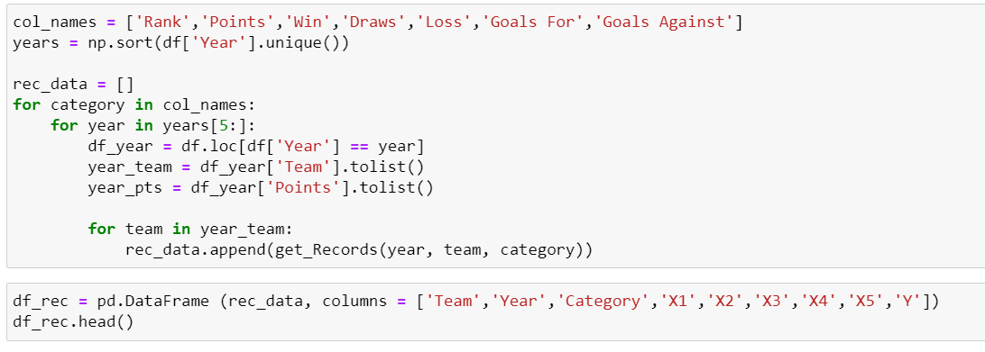
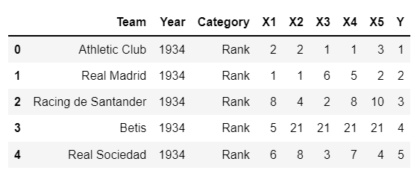
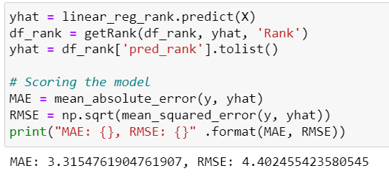
CAN WE PREDICT THE TEAMS ‘RANK’ FOR EACH SEASON?
Used Linear Regression in order to predict the actual rank based on data from the last 5 years
16

Slide 17
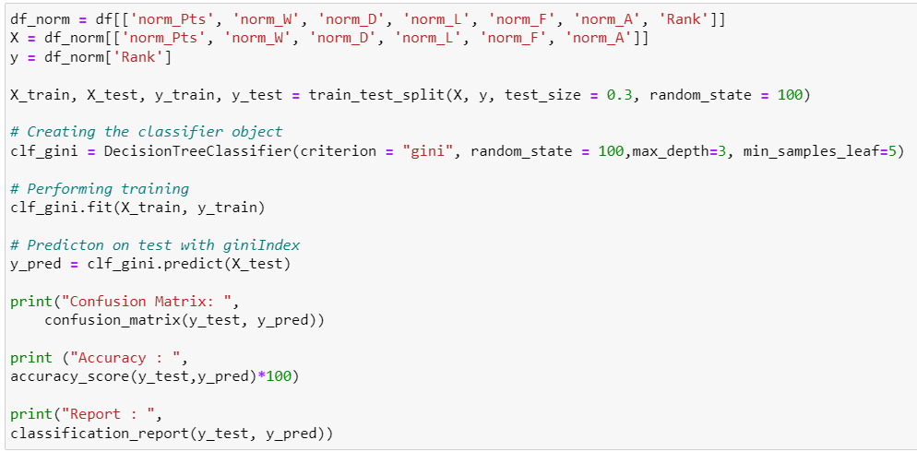
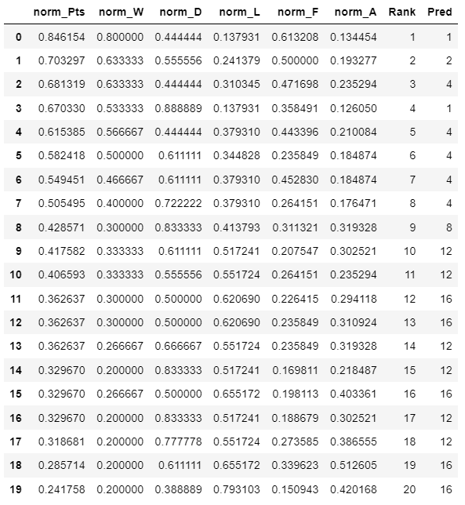
CAN WE PREDICT THE TEAMS ‘RANK’ FOR EACH SEASON?
Used Decision Tree in order to predict the rank based on normalized columns that we created
17

Slide 18
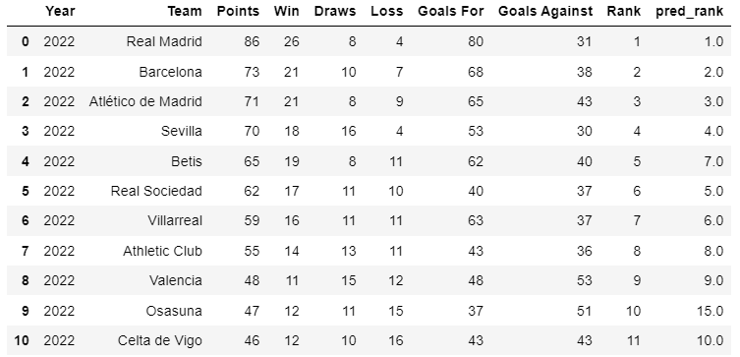
PREDICTED RANK IN 2021/2022
18

Slide 19
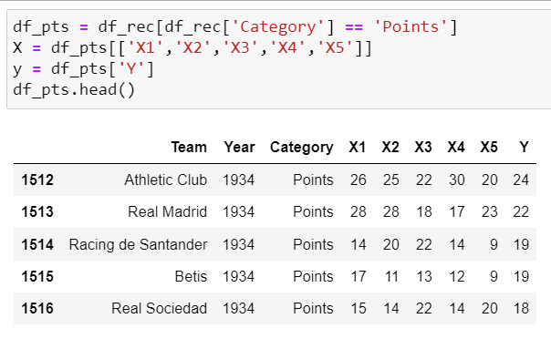
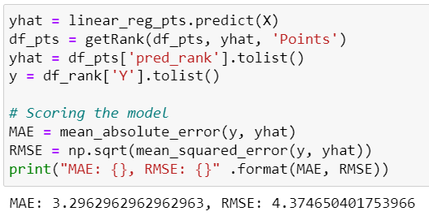
CAN WE PREDICT THE TEAMS ‘POINTS’ FOR EACH SEASON?
Used Linear Regression in order to predict the actual points based on data from the last 5 years
19

Slide 20
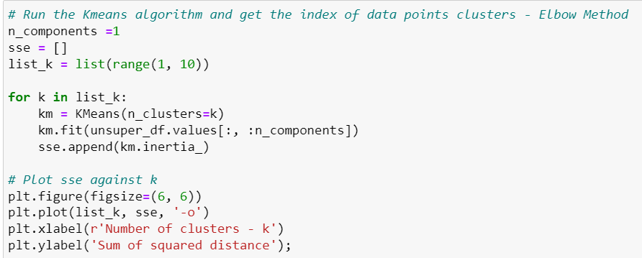
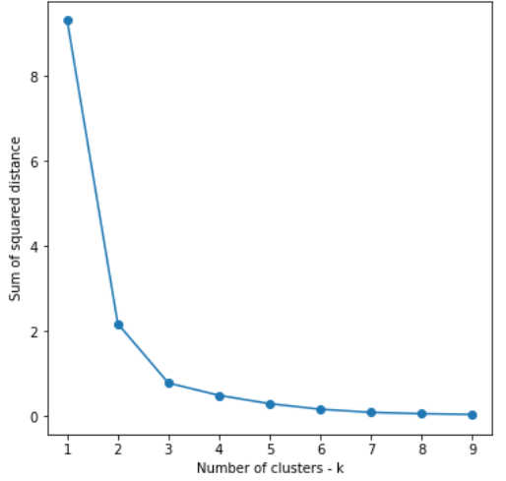

CAN WE CLASSIFY THE TEAMS INTO GROUPS AND SEE HOW OUR DATA AFFECT THE CLASSIFICATION?
Used K-means in order to classify the teams based on our data set
20

Slide 21
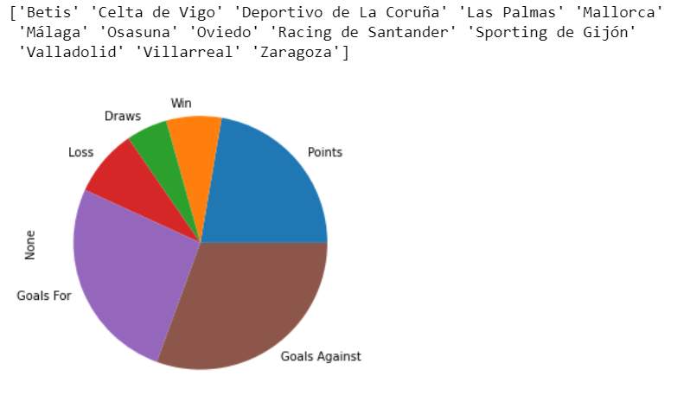
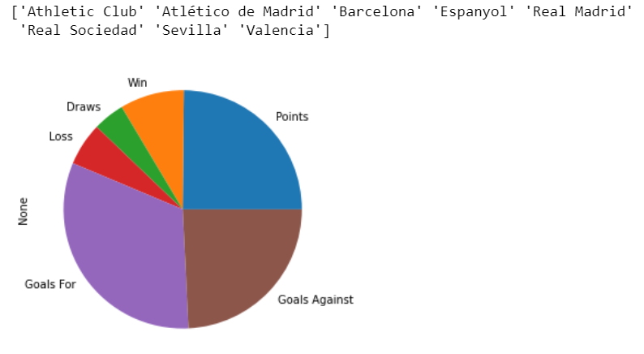
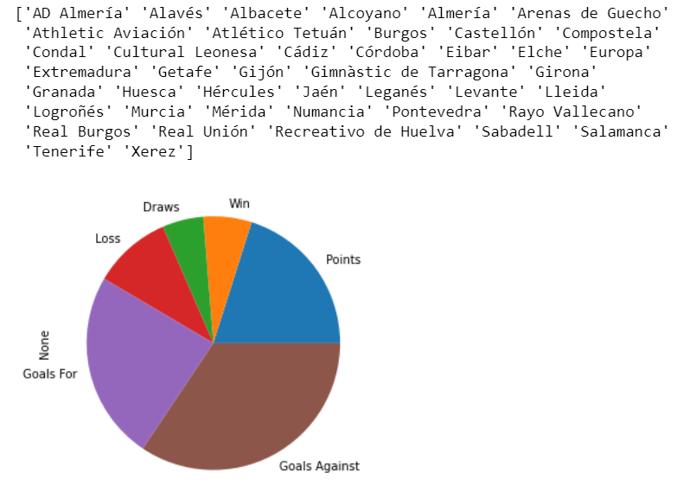
CAN WE CLASSIFY THE TEAMS INTO GROUPS AND SEE HOW OUR DATA AFFECT THE CLASSIFICATION?
Based on our unnormalized data
21

Slide 22
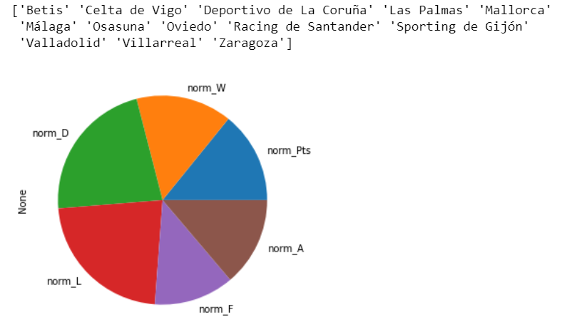
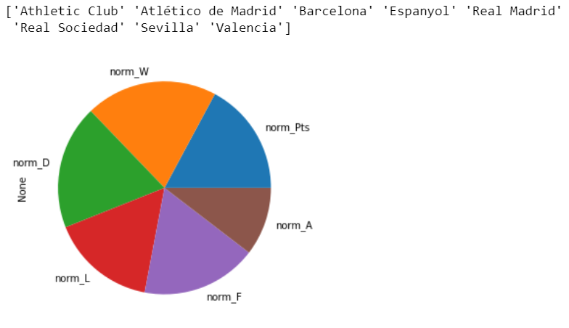
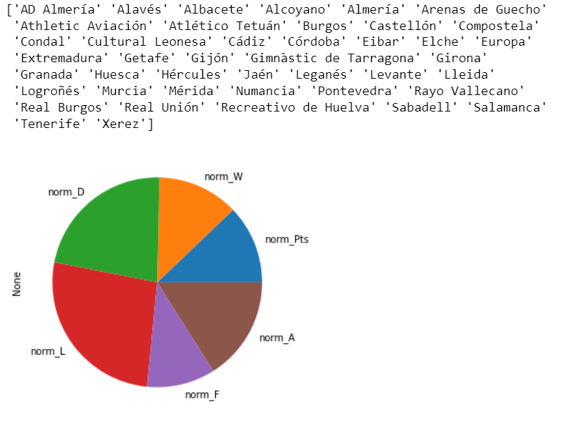
CAN WE CLASSIFY THE TEAMS INTO GROUPS AND SEE HOW OUR DATA AFFECT THE CLASSIFICATION?
Based on our normalized data
22

Slide 23
SUMMARY AND CONCLUSIONS
To conclude, we tried to predict the rank and points using ML models – Linear Regression and Decision Tree.
Trying to predict the rank using Linear Regression seems to be pretty accurate.
The errors using “Points” or “Rank” data are quiet equal according MAE and RMSE values.
However, Decision Tree model got low accuracy because we tried to predict a numerical value, and not a classification problem.
In addition, we tried to classify the teams into several groups by using an unsupervised model, and we saw how the different characteristics affect the classification
23

